Slide 1
Rafael Nadal
Focus and concentration

Slide 2
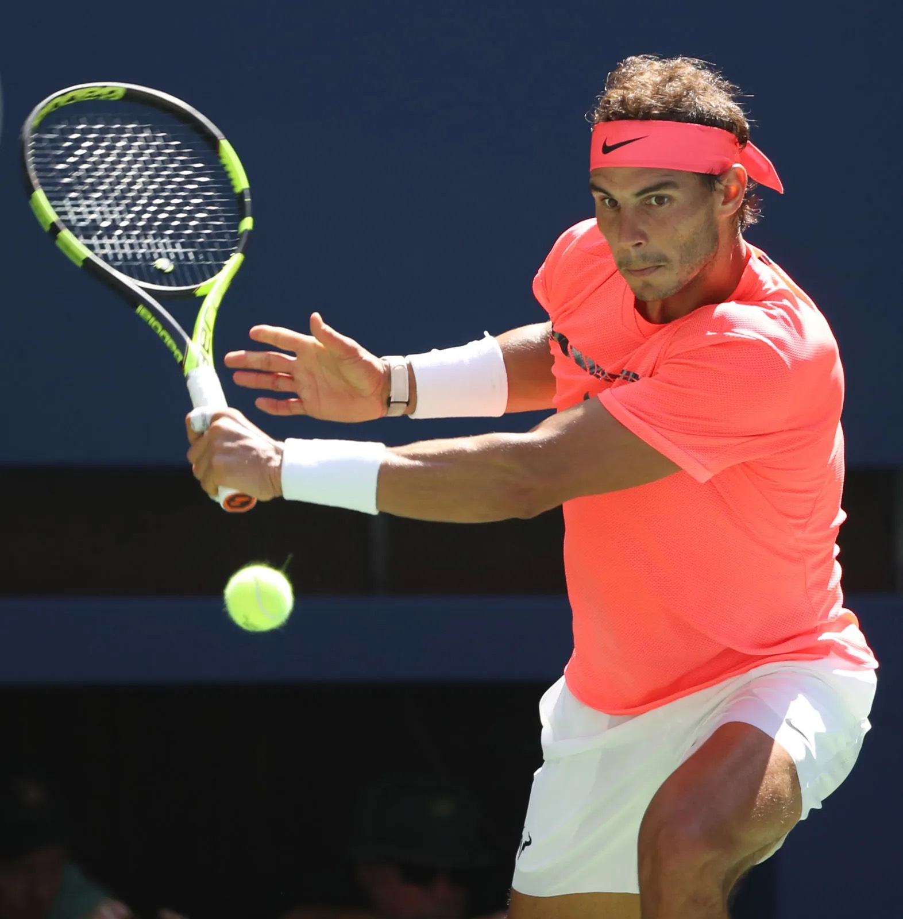
"Tennis is a mentally aggressive sport. It demands you at all times. One has to be able to find a way to focused on what one is doing almost 100%, without being distracted by external things,

Slide 3
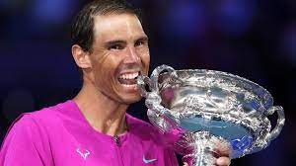
"I achieve that state of concentration by doing all the rituals I do. I don't know if it's something positive or negative, but it works for me. I have some rituals that help me feel focused on what I'm doing. It's the way to differentiate when I'm competing from the rest of my life

Slide 4
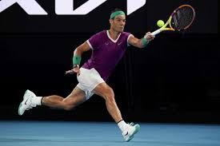
These moves are part of Nadal’s routine to make his mind ready for every serve. There are more than ten well-documented rituals he systematically performs before or during a match, which include:
He removes his jacket while jumping.
He places his bottles in the same exact position.
He wipes himself with a towel after each point.
But why is he doing so?
“It’s a way of placing myself in a match, ordering my surroundings to match the order I seek in my head. …when I do it, it means I’m focused.”

Slide 5
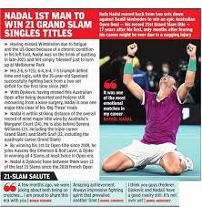
For me, the only failure is not trying. If I am going to play the Australian Open and come back after losing in the first round, but I have made an effort and I have the right attitude during the preparation week is not a failure

